Slide 1
Intro to Artificial Intelligence Mohamad Nassar
Introduction
Notes:
Slides and exercises are inspired by Russell & Norvig AI Book, Stanford’s AI course and from Berkeley’s AI course

Slide 2
Course Plan
Concepts
Applications
Introduction
Search algorithms
Probability in AI
Bayesian inference
Supervised learning
Unsupervised learning
Logic and planning
Reinforcement learning
Markov models
Robotics
Natural Language Processing

Slide 3
Grading
Participation and attendance: 5%
Weekly or Bi-weekly assignments: 20%
Midterm: 25%
Final: 25%
Project: 25%

Slide 4
Reference Book
Russell & Norvig, AIMA, 4th Ed.

Slide 5
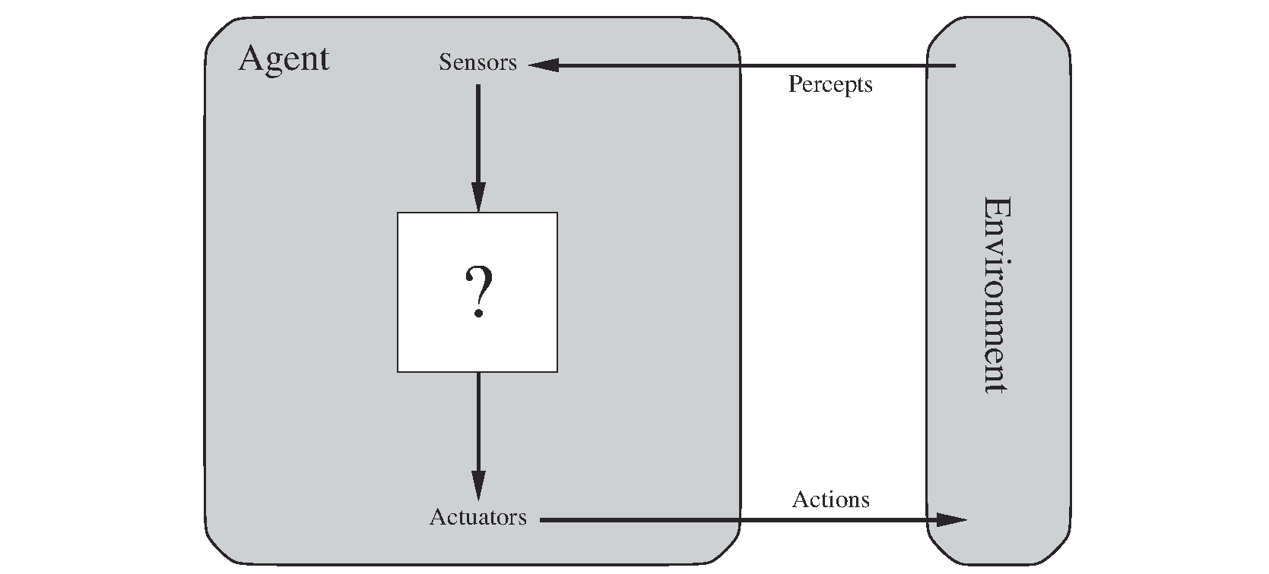
What is an agent?

Slide 6
Examples
Google translator
Collect examples of translation
Medicine
Finance
Games
Robotics
The web

Slide 7
Natural language processing
Language identification
Segmentation
Spell checking
Translation

Slide 8
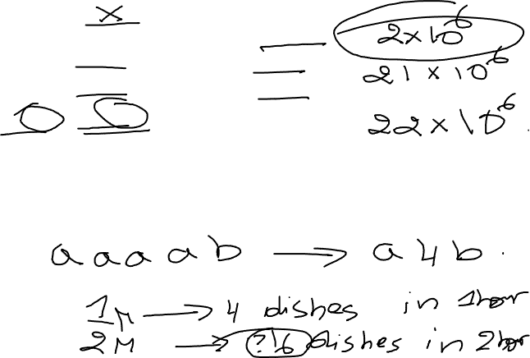
Language classification using gzip!
(echo `cat file EN-file | gzip | wc –c` ENGLISH; \
echo `cat file DE-file | gzip | wc –c` DEUTSCH; \
echo `cat file FR-file | gzip | wc –c` FRENCH)\
| sort –n | head -1
file: contains a sentence to be classified
EN-file: contains English text
…

Slide 9
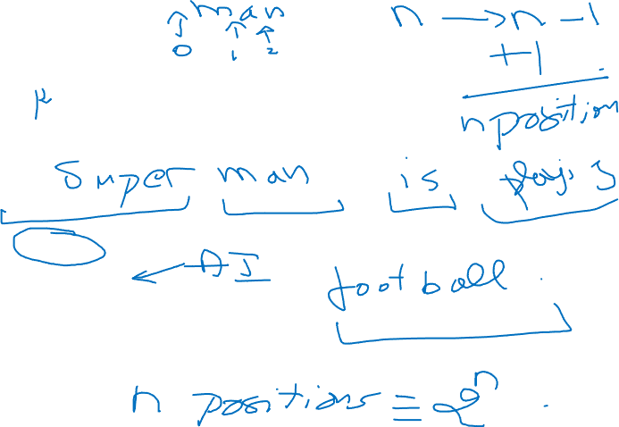
Segmentation
Supermanisplayingfootball
How many possibilities to cut this in many words?
Urls:
Visitspain.com
Visit Spain ?
Or visits Pain ?
Notes:
2^n-1

Slide 10
Robotics

Slide 11
Computer vision
How can I make a 3D representation of a 2D image?
How to compute the depth of a given point?

Slide 12
What you will be able to solve at the end of the course? Things that if you know you are probably making a mistake by taking this class!

Slide 13
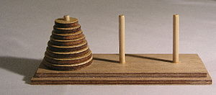
Towers of Hanoi
Identify it as a search problem
Identify a good search heuristic
Identify the number of possible states
Identify the number of steps for the optimal solution
Notes:
Nb of possible states : 3^d
2^d-1

Slide 14
Bayes networks
What are Bayesian Networks ?
How many parameters do we need to represent them?
what is conditional independence and how it is represented by the d-separation graph property?
A
C
B
E
H
D
G

Slide 15
Machine learning algorithms
What is the difference between K-nearest neighbors and K-Means?
How to use smoothing in order to mitigate the effects of noise in the data?
When adding more data to our model is useless ?

Slide 16
Planning
How to model planning problems using relations and actions, and how to solve them?
Action (Buy(book))
PRE: Available(book)
CONSUME: Dollars(50)
EFF: Have(book)

Slide 17
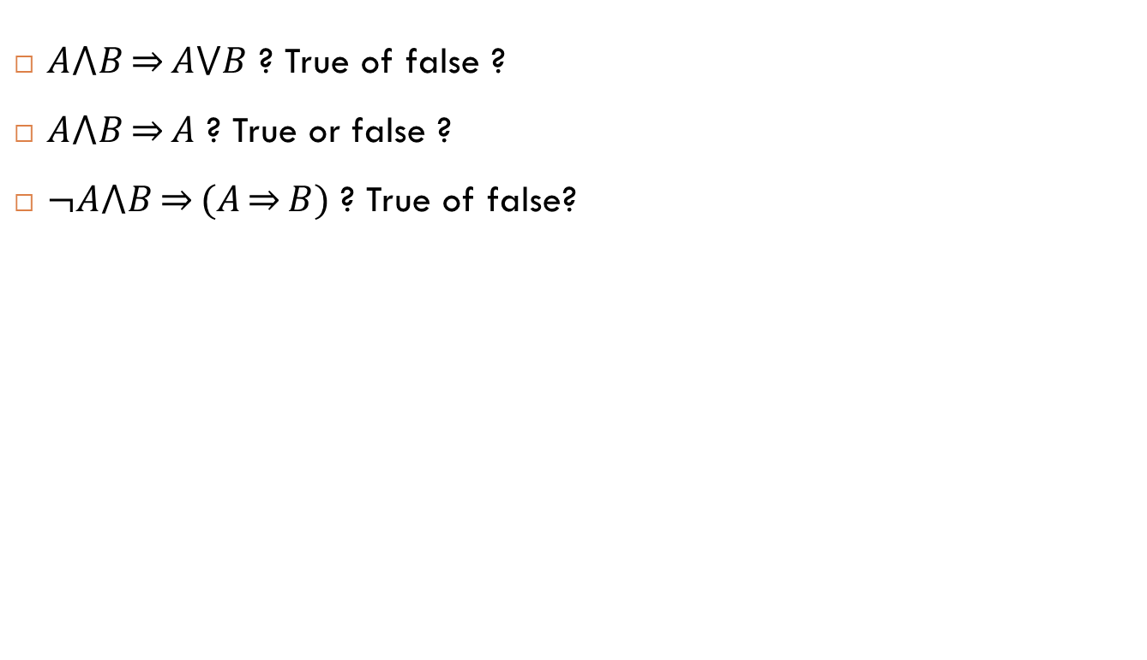
Logic
$A⋀B\overset{⇒}{}A⋁B$ ? True of false ?
$A⋀B\overset{⇒}{}A$ ? True or false ?
$¬A⋀B\overset{⇒}{}(A\overset{⇒}{}B)$ ? True of false?

Slide 18
Particle filters
How a robot can localize himself in a stochastic environment using perception?

Slide 19
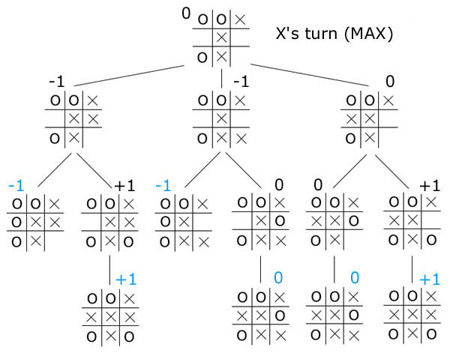
Min-Max search in games
How to use alpha-beta pruning in order to shrink the search space?

Slide 20
Much more!
Value iteration
Markov chains
Hidden Markov models (HMM)
Spam detection
Maximum likelihood estimation
…

Slide 21
Programming assignments - Why Python?
Completeness
Python / Ruby
C/C++
Productivity
Performance
Domain specific languages: OpenGL, Liszt

Slide 22
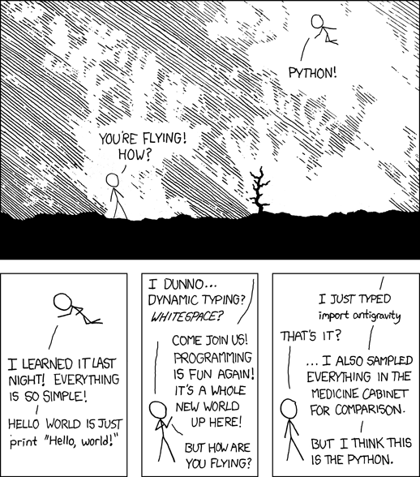
Why Python? (xkcd comics)

Slide 23
All we need is some Math
Select all of the following statements that are true.
2^{(x∗y)}=2^{x}2^{y}
2^{(x+y)}=2^{x}2^{y}
2^{(x+y)}=2^{x}+2^{y}
log(3^{x})=log(3).log(x)
log(3^{x})=x.log(3)
log(3^{x})=3x
None of the above.
Notes:
Ans : 2^{(x+y)}=2^{x}2^{y}
log(3^{x})=x.log(3)

Slide 24
Linear equations
You know that x=(1/2)y+(1/2)(x+1)
and y=(1/3)y+(1/3)(x+2).
Find x and y
Notes:
X=4
Y=3

Slide 25
Conditional probability
Select all of the following statements that are true for all joint distributions over X and Y.
P(x,y)=P(x)P(y)
P(x,y)=P(x|y)P(y)
P(x,y)=P(x|y)P(y|x)
P(x)=∑_{y}P(x|y)
P(x)=∑_{y}P(x,y)
None of the above.
Notes:
P(x,y)=P(x|y)P(y)
P(x)=∑_{y}P(x,y)

Slide 26
Expectation
Someone rolls a fair six-sided die and you win points equal to the number shown.
What is the expected number of points after one roll?
After 2 rolls?
After 100 rolls?
Notes:
3.5
After 2 rolls? 7
After 100 rolls? 350

Slide 27
Permutations and combinations
You are playing a solitaire game in which you are dealt three cards without replacement from a simplified deck of 10 cards (marked 1 through 10). You win if one of your cards is a 10 or if all of your cards are odd.
How many winning hands are there if different orders are different hands?
What is your chance of winning?
Notes:
276
0.38

Slide 28
Hashing
Which critical operation is generally faster in a hash table than in a linked list?
Inserting an element into the data structure
Testing for the membership of an element in the data structure
On average, how fast is this operation in a hash table?
O(1)
O(n)
O(log n)
O(n²)
None of the above.
On average, how fast is this operation in a linked list?
O(1)
O(n)
O(log n)
O(n²)
None of the above.
Notes:
Membership testing
O(1)
O(n)

